Slide 1
The Joy of Finally Learning
www.mldawn.com

Slide 2
Outline of the Talk
What is an Artificial Neural Network (ANN)?
What is a Perceptron?
Bayes’ Rule and Birth of Error Functions (with Derivations)
The Birth of Binary-Cross Entropy Function (with Derivations)
Forward Pass and Backward Pass in a Binary Classifier
A Demo

Slide 3
What is a neural network?
An ANN is a function approximator!
What is a function?
Examples of functions: real-valued, discrete-valued, and vector-valued
Applications of ANNs:
Recognizing hand-written characters
Recognizing spoken words
Recognizing faces
Notes:
MNIST
Speech Recognition
Face

Slide 4
What is a neural network?
_{Unknown Function !!!}
$\overline{f} ( )≡$ $ANN$
$$x$$
$$f( )$$
$$f(x)$$
_{Image}
_{Stock Information}
_{Car Information}
Cat / Dog (Prob. Vector)
Price ($) (real-valued)
Number (discrete-valued)
$\overline{f} ( )≈$ $f( )$
_{ANN approximates} $f( )$ _{for us}

Slide 5
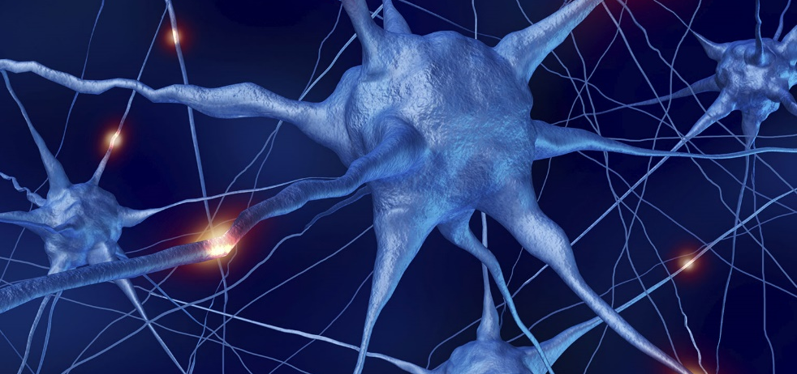
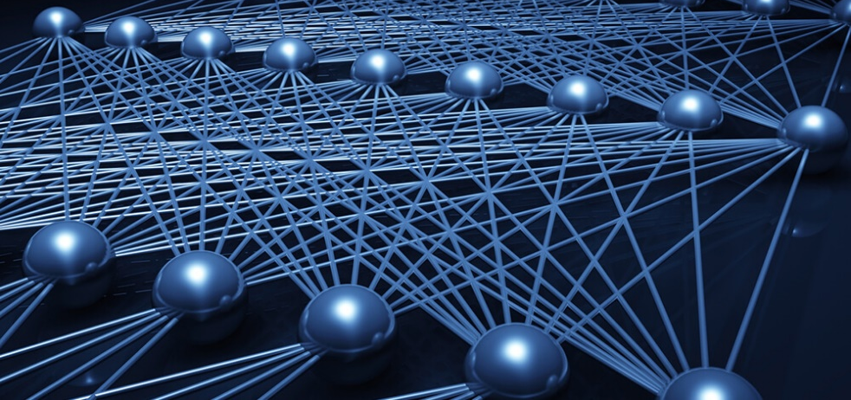
ANN Biological motivation
ANNs are inspired by Biological Learning Systems (BLS)
BLS: A massive interconnection of neurons
ANNs:
Densely interconnected set of simple unites

Slide 6
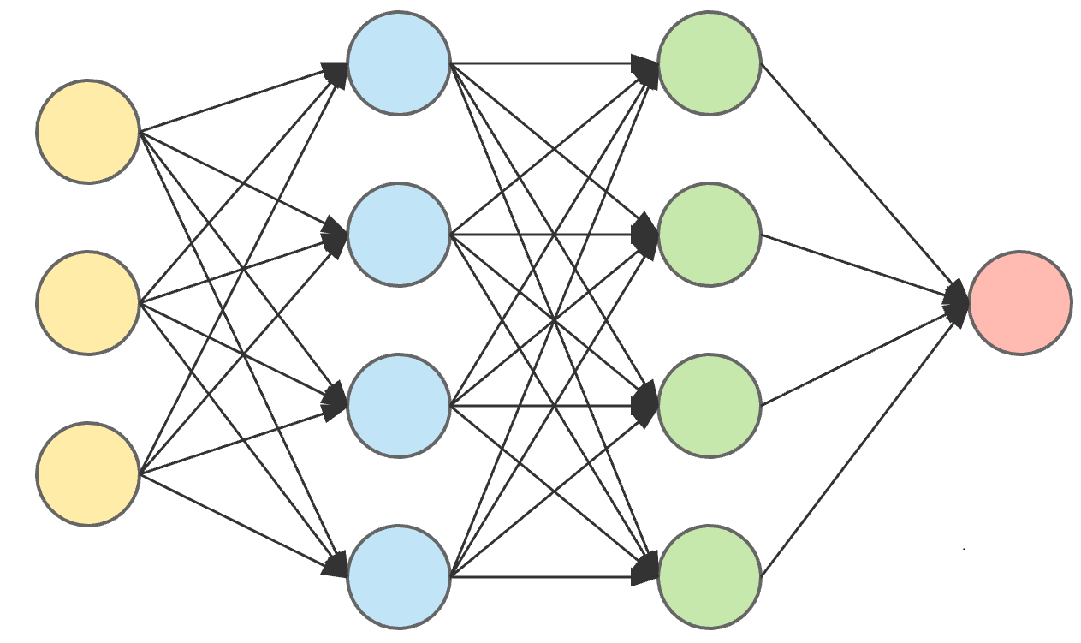
ANN Biological motivation
For each unit in ANN:
Possibly several inputs
A Single real-valued output
BLS processes are highly parallelized
Over nearly ${10}^{11}$ neurons
ANNs do NOT fully reflect a BLS
Output of neurons are different
Researchers try to:
Model BLS processes
Develop effective ANNs (no regards to BLS compatibility)
Notes:
Over nearly ${10}^{11}$ neurons each connecting to ${10}^{4}$ other neurons!!!
Output of neurons are different: 1) ANNs: For every unit the output is a SINGLE CONSTANT value 2) BLS: A biological neuron’s output is a complex timeseries of spikes!

Slide 7
Simplest ANN A Perceptron

Slide 8
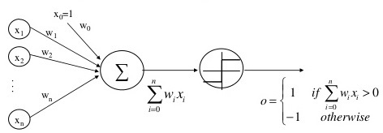
A perceptron
A type of ANN that is based on a unit called perceptron
There is a rule about input/output of a perceptron:
Input: A vector of real-valued data
Linearly combine the components of the input
$o\left(x_{1},…,x_{n}\right)=\left\{\begin{aligned}+1 \\ −1\end{aligned}\right.$
$$if w_{0}+w_{1}x_{1}+w_{2}x_{2}+…+w_{n}x_{n}>0$$
$$Otherwise$$

Slide 9
A perceptron
What are the weights? What is that $w_{0}$?
Let’s imagine an additional input
$x_{0}=1$
This simplifies the inequality:
$\sum_{i=0}^{n}{w_{i}x_{i}>0}$
Or in vector form: $\overset{⃑}{w}.\overset{⃑}{x}>0$
Can we show the perceptron smarter?
$o\left(\overset{⃑}{x}\right)=sgn⁡(\overset{⃑}{w}.\overset{⃑}{x})$
Where: $sgn\left(z\right)=\left\{\begin{aligned}+1 \\ −1\end{aligned}\right.$
Learning a perceptron = Choosing the weights
The hypothesis space: $H=\left\{\overset{⃑}{w} \right|\overset{⃑}{w} ∈R^{(n+1)}\}$
If z > 0
otherwise

Slide 10
A Perceptron: A deeper look
$$x_{0}=1$$
$$w_{0}$$
$$w_{1}$$
$$z$$
$$sgn⁡(z)$$
$$x_{1}$$
$$y$$
$$z$$
$$z$$
$$sgn⁡(z)$$
$$x_{1}$$
$$x_{1}$$
$$x_{1}$$

Slide 11
A Perceptron: A deeper look
$$x_{0}=1$$
$$w_{0}$$
$$x_{1}$$
$$w_{1}$$
$$w_{2}$$
$$z$$
$$sgn⁡(z)$$
$x_{2}$
$$y$$
$$z$$
$$z$$
$$sgn⁡(z)$$
$$x_{1}$$
$$x_{1}$$
$$x_{1}$$
$$x_{2}$$
$$x_{2}$$
$$x_{2}$$

Slide 12
The Birth of Error Functions Do I trust my ANN?

Slide 13
Bayes’ Rule
Let’s assume the following notation:
M : Our Model
D: Our Evidence
Then the Bayes’ Rule:
$$P\left(M|D\right)=\frac{P\left(D|M\right)P\left(M\right)}{P\left(D\right)}$$

Slide 14
Taking the Logs() : A Simplification
$$\log\left(\frac{a}{b}\right)=\log\left(a\right)−log⁡(b)$$
$$P\left(M|D\right)=\frac{P\left(D|M\right)P\left(M\right)}{P\left(D\right)}$$
$$\ln{P\left(M | D\right)=\ln\left[P\left(D|M\right)P\left(M\right)\right]−\ln{P(D)}}$$
$$\log\left(a×b\right)=\log\left(a\right)+log⁡(b)$$
$$\ln{P\left(M | D\right)=ln P\left(D|M\right)+ ln P(M){−\ln{P(D)}}}$$

Slide 15
The Bayesian Machinery (MAPE)
$$\ln{P\left(M | D\right)=ln P\left(D|M\right)+ ln P(M){−\ln{P(D)}}}$$
$$Maximize P\left(M | D\right)≡Minimize −P(M|D)$$
$$−ln{P\left(M | D\right)=−ln P\left(D|M\right)− ln P(M){+\ln{P(D)}}}$$
$$This is how Bayes^{′} Rule$$
$$connects to Error Functions$$
$$E= −ln{P\left(M | D\right)}$$

Slide 16
MAPE and ANNs : Supervised Learning
How can we apply the MAPE to an ANN with weights w?
Let’s assume that we have a set of examples (di,ti) where di is the i-th input and ti the corresponding target.
Then we can rewrite the likelihood as:
$$P \left(D | M\right) and D≈(d_{i} , t_{i})$$
ANN
$$P \left(D | M\right)= P \left((d_{i}, t_{i}) | M\right)$$
$$d$$
$$y \& t$$
$P \left((d_{i}, t_{i}) | M\right)=P(t_{i}|d_{i}, M)×P(d_{i}|M)$
$$P(d_{i})$$

Slide 17
MAPE and ANNs : Supervised Learning
$$−ln{P\left(M | D\right)=−ln P\left(D|M\right)− ln P(M){+\ln{P(D)}}}$$
$$Model indeed means our weights W$$
$$P\left(D\right)and P\left(d_{i}\right) are both$$
$$independent of$$
$$our weights W. Ignore$$
$$them during Maximization$$
$$−ln{P\left(W | D\right)=−ln P\left(D|W\right)− ln P(W){+\ln{P(D)}}}$$
$P(t_{i}|d_{i}, W)×P(d_{i})$
$−ln{P\left(W | D\right)=−\ln{\prod_{i=1}^{N}{\left[P\left(t_{i} | d_{i}, W\right)×P\left(d_{i}\right) \right]−\ln{P\left(W\right)+\ln{P(D)}}}}}$
$−ln{P\left(W | D\right)=−\sum_{i=1}^{N}{\ln\left[P\left(t_{i} | d_{i}, W\right)×P\left(d_{i}\right)\right]−\ln{P\left(W\right)+\ln{P(D)}}}}$
$$−ln{P\left(W | D\right)=−\sum_{i=1}^{N}{\ln\left[P\left(t_{i} | d_{i}, W\right)\right]−}}\sum_{i=1}^{N}{\ln{P\left(d_{i}\right)}}−\ln{P\left(W\right)+\ln{P(D)}}$$

Slide 18
MAPE and ANNs : Supervised Learning
$$−ln{P\left(W | D\right)=−\sum_{i=1}^{N}{\ln\left[P\left(t_{i} | d_{i}, W\right)\right]−}}\ln{P\left(W\right)}$$
$$Can be used for regularizing W$$
$$to avoid overfitting$$
$$P\left(W\right)= \frac{1}{\sqrt{2π}σ}e^{\frac{−{(w − μ)}^{2}}{2σ^{2}}}$$
$$\ln{( )}$$
$$≈−(w_{1}^{2}+w_{1}^{2}+…+w_{N}^{2})$$
$$E= −ln{P\left(W | D\right)=−\sum_{i=1}^{N}{\ln\left[P\left(t_{i} | d_{i}, W\right)\right]}}$$

Slide 19
Binary Cross-Entropy Error Function The Derivation

Slide 20
Binary Classification
We have 2 classes: Positive and Negative
Binary Classification:
$t_{i}=1$ means that $x_{i}$ belongs to the positive class
$t_{i}=0$ means that $x_{i}$ belongs to the negative class
Artificial Neural Networks (ANNs): Probabilistic approach
ANN computes the probability of the Positive Class: $P\left(y_{i}=1 \right| x_{i})$
Could a linear model work? Say, $y= w^{T}x+b$ → Not Bounded!
We need a Squasher!

Slide 21
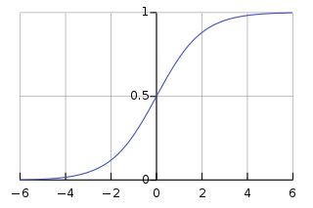
Binary Classification
$$x_{0}=1$$
$$w_{0}$$
Input
$$w_{1}$$
$$z$$
$$y=σ\left(z\right)=\frac{1}{1+ e^{−z}}$$
Output [0, 1]
$$\left\{\begin{aligned}t_{i}=1 \\ t_{i}=0\end{aligned}\right.$$
$$x_{1}$$
...
$$Sigmoid$$
$$x_{n}$$
$$w_{n}$$
Compute Error
Back-Propagation

Slide 22
Binary Classification
The output of our ANN is probability. Let’s denote:
$y_{i}:$ Probability $x_{i}$ belongs to the Positive class (i.e., $t_{i}=1$)
${(1−y}_{i}):$ Probability $x_{i}$ belongs to the Negative class (i.e., $t_{i}=0$)
$$P\left(t_{i} | d_{i}, w\right)=\left\{\begin{aligned}y_{i} if t_{i}=1 \\ 1−y_{i} if t_{i}=0\end{aligned}\right.$$
Bernoulli Distribution
$$P\left(t_{i} | d_{i}, w\right)=y_{i}^{t_{i}}{(1 −y_{i})}^{1−t_{i}}$$

Slide 23
Binary Classification
$$P\left(t_{i} | d_{i},w\right)=y_{i}^{t_{i}}{(1 −y_{i})}^{1−t_{i}}$$
$$E={−\sum_{i=1}^{N}{\ln\left[P\left(t_{i} | d_{i}, W\right)\right]=−\sum_{i=1}^{N}{\ln{[y_{i}^{t_{i}}{(1 −y_{i})}^{1−t_{i}}]}}}}$$
$$={−\sum_{i=1}^{N}{[\ln{y_{i}^{t_{i}}}+\ln\left(1−y_{i}\right)]}}$$
$$E={−\sum_{i=1}^{N}{[t_{i}\ln{y_{i}}+\left(1 −t_{i}\right)ln⁡(1−y_{i})]}}$$

Slide 24
Forward pass
$$x_{0}=1$$
$$w_{0}$$
$$w_{1}$$
$$z$$
$$y=σ\left(z\right)=\frac{1}{1+ e^{−z}}$$
$$x_{1}$$
$$E=−t×\ln{y} −\left(1−t\right)×\ln{(1−y)}$$
$$Sigmoid$$
$$Error=E\left(σ(Z)\right)=E(σ(w_{1}x_{1}+w_{0}))$$
$$y$$
$$Z$$
Binary Cross-Entropy Error Function
Binary Cross-Entropy Error Function

Slide 25
Backward pass
$$\frac{∂E}{∂w_{1}}=\frac{∂E}{∂y}×\frac{∂y}{∂Z}×\frac{∂Z}{∂w_{1}}=\left[\frac{−t}{y}+\frac{(1−t)}{(1−y)}\right]×y\left(1−y\right)×x_{1}=(y −t)×x_{1}$$
$$\frac{∂E}{∂w_{1}}=\frac{∂E}{∂y}×\frac{∂y}{∂Z}×\frac{∂Z}{∂w_{0}}=\left[\frac{−t}{y}+\frac{(1−t)}{(1−y)}\right]×y\left(1−y\right)×x_{0}=(y −t)$$
So the learning rule for both our learnable parameters (i.e., weights) is as follows:
$$w_{1}=w_{1}−η×\frac{∂E}{∂w_{1}}=w_{1}−η×[(y−t)×x_{1}]$$
$$w_{0}=w_{0}−η×\frac{∂E}{∂w_{0}}=w_{0}−η×(y−t)$$

Slide 26
www.mldawn.com
@MLDawn2018
Mehran Bazargani
The Joy of Finally Learning
ML Dawn
Course Available at: https://www.mldawn.com/course/the-birth-of-error-functions/
Demo’s Code: https://www.mldawn.com/binary-classification-from-scratch-using-numpy/
Notes:
I hope that this has been informative for you. Cheers everybody!

